Slide 1
Aakash Goel https://www.linkedin.com/in/goelaakash123/
Session 1:
Introduction to Computer Vision
Acknowledgement: Slide Materials adopted from - Intro to Computer Vision (Cornell Tech); Noah Snavely, prepared by the lead instructor Prof S P Vimal , modified (added some content) by Aakash Goel

Slide 2
Course Objectives
CO1: Students should understand the fundamentals of a camera producing an image, including camera calibration, optical distortions, perspective corrections etc.
CO2: Students should be familiar with various building block algorithms in Computer Vision, including Image processing and Deep Learning with emphasis on the algorithm building blocks.
CO3: Students should create at least one end-user application.

Slide 3
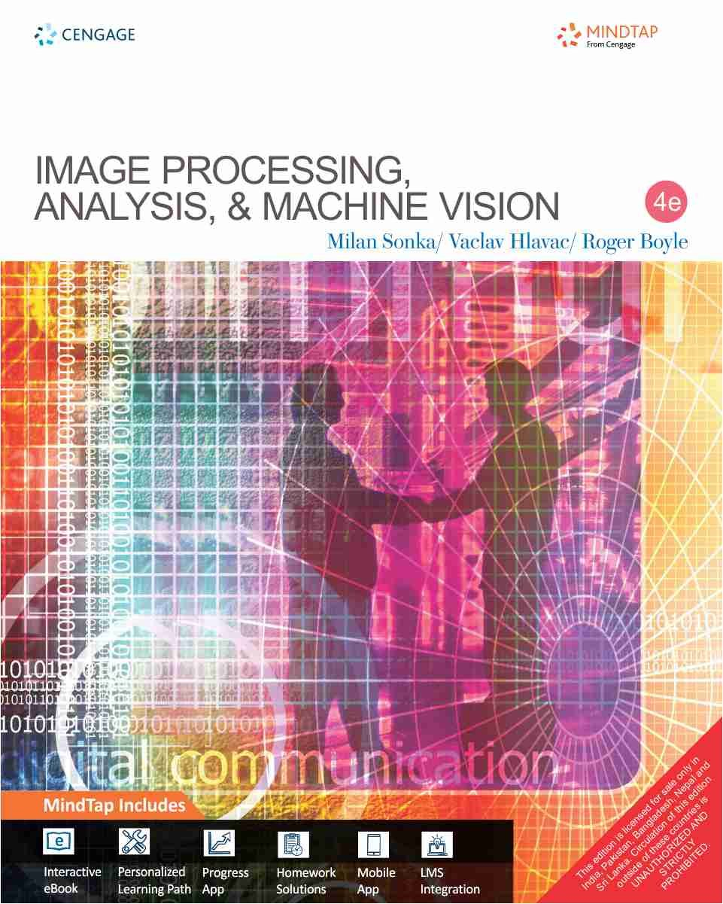
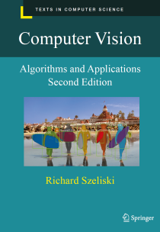
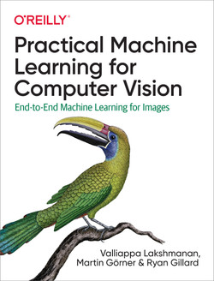
Textbook-1:
Image Processing, Analysis, and Machine Vision: Milan Sonka, Vaclav Hlavac, Roger Boyle, Fourth edition, Cengage Learning
Reference-1:
Rick Szeliski, Computer Vision: Algorithms and Applications
Online at: http://szeliski.org/Book/
Reference-2:
Practical Machine Learning for Computer Vision:
End-to-End Machine Learning for Images, O’Rielly, 2021

Slide 4
Evaluation Plan
Evaluation
Two Quizzes for 5% each; Best one towards final grading; No Makeup; → 5%
Two Assignments – x % + y % = 25%
Mid Term Exam - 30%
Comprehensive Exam - 40%
Webinars/Tutorials
4 tutorials : 2 before mid-sem & 2 after mid-sem
Teaching Assistant: TBD

Slide 5
What will you learn in this course?
Computer Vision Fundamentals; (~2 Sessions )
Selected Topics in Low Level Vision & Mid Level Vision; (~3 Sessions)
Review of Deep Learning Approaches for Computer Vision ( ~ 1 Session) [ As Webinar ]
Image Classification – Problem, Deep Learning Architectures, Metrics, Use cases. ( ~2 Sessions)
Classic & Modern Approaches, Applications for
(a) Object Detection, Recognition (~2 Sessions )
(b) Face Detection, Recognition ( ~1 Session ) [ As Webinar ]
(c) Object Tracking (~2 Sessions)
(d) Object Segmentation ( ~2 Sessions)
(e) OCR (~ 1 Session) [ As Webinar ]
Visual Bag of Words & Semantic Hierarchy (~1 Session)
Edge Devices for Computer Vision (~1 Session ) [ As Webinar ]

Slide 6
What will you learn in this course?
On your learning
Reading materials given at the end of each class
Most of the topics needs to balance depth and breadth. We will use research articles and other online materials quite frequently.
Python demonstrations will be part of regular classes as required 🡪 TA’s will join the lectures sessions to support with demonstration.
Wherever necessary, stress will be given to related classic topics in Computer Vision.
Assignment problems [to be solved in a group of maximum of 4 members ] will be given on natural images and remote sensing images & you can make a choice.

Slide 7
Plagiarism Policy
All submissions for graded components must be the result of your original effort. It is strictly prohibited to copy and paste verbatim from any sources, whether online or from your peers. The use of unauthorized sources or materials, as well as collusion or unauthorized collaboration to gain an unfair advantage, is also strictly prohibited.
Please note that we will not distinguish between the person sharing their resources and the one receiving them for plagiarism, and the consequences will apply to both parties equally.
In cases where suspicious circumstances arise, such as identical verbatim answers or a significant overlap of unreasonable similarities in a set of submissions, will be investigated, and severe punishments will be imposed on all those found guilty of plagiarism.

Slide 8
Agenda
Introduction to the course:
What is Computer Vision?
Why Computer Vision is hard?
Applications of Computer Vision
Image representation and image analysis tasks

Slide 9
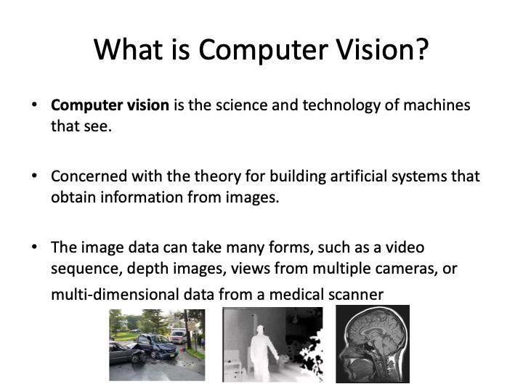
CV 1: Introduction to Computer Vision

Slide 10
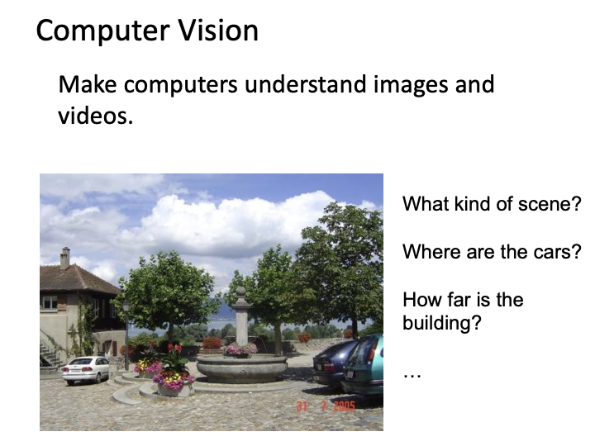
CV 1: Introduction to Computer Vision

Slide 11
CV 1: Introduction to Computer Vision
🟨 What Computer Vision is the field of study where we teach machines to "see" and make sense of visual data like images and videos.
🟦 Why: So that machines can automate visual tasks — from recognizing faces to checking product quality in factories.
🟥 Who: Used by industries like healthcare, automotive, agriculture, and security.
🟩 Where: Anywhere you deal with visual data: airports (facial recognition), hospitals (MRI scans), or even Instagram filters.
🟧 How: We turn images into numbers, then use algorithms to extract patterns, classify objects, or detect changes.
🧠 Analogy:
“Imagine a 3-year-old child seeing a cat—they don’t just see fur or ears; they recognize the pattern as 'cat'. In Computer Vision, we train machines to do the same but using pixel values and mathematical patterns.”

Slide 12
CV 1: Introduction to Computer Vision
Why is Computer Vision Hard?
🔎 Real-world Challenges:
Lighting Changes – A white car during the day vs at night
Viewpoint Variation – Object looks different from different angles
Occlusion – Part of the object is hidden
Intra-Class Variation – All dogs are not the same
Background Clutter
🧠 Analogy:
“Imagine playing a game where you have to guess what’s behind a frosted glass window. That’s how a computer often sees an image—with distortions, noise, and ambiguity.”

Slide 13
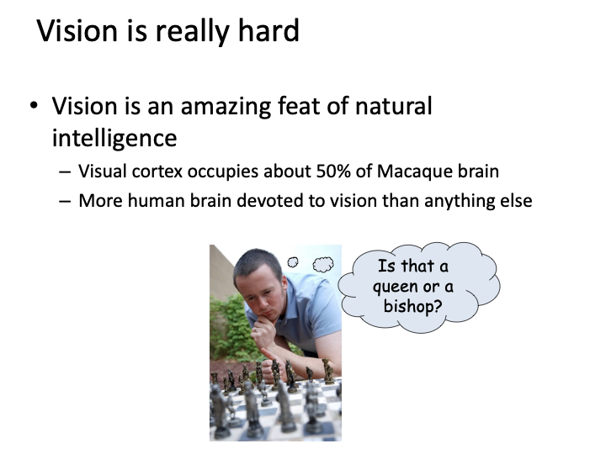
CV 1: Introduction to Computer Vision

Slide 14

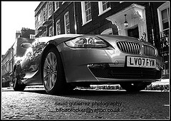
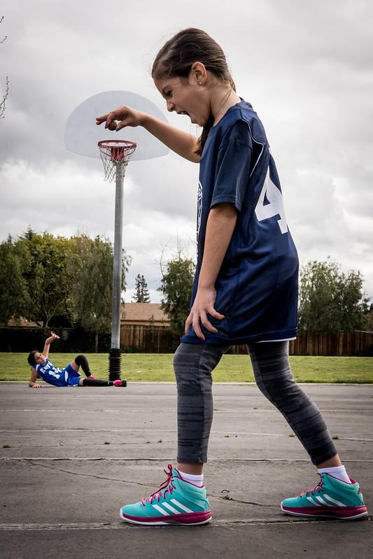
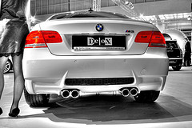
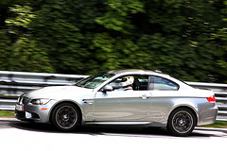
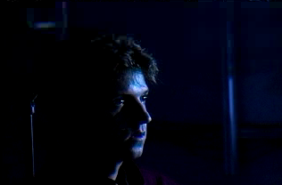
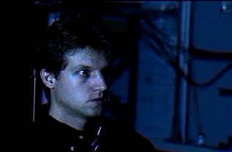
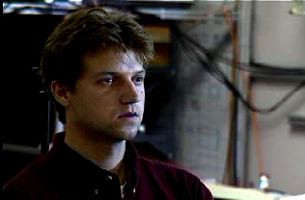
Why is computer vision difficult?
Viewpoint variation
Credit: Flickr user michaelpaul
Scale
Illumination

Slide 15
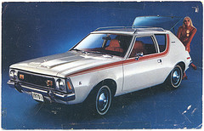
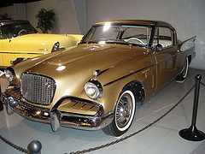
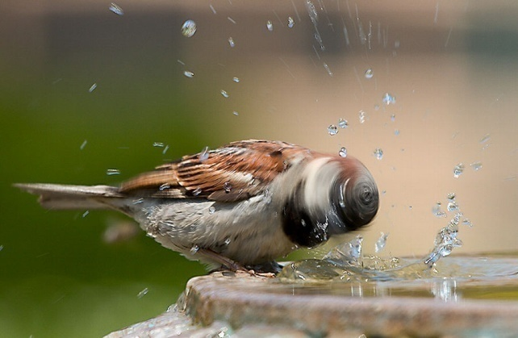
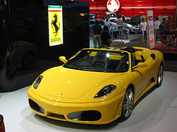
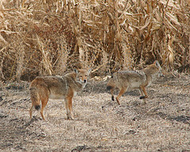
Why is computer vision difficult?
Motion (Source: S. Lazebnik)
Intra-class variation
Background clutter

Slide 16
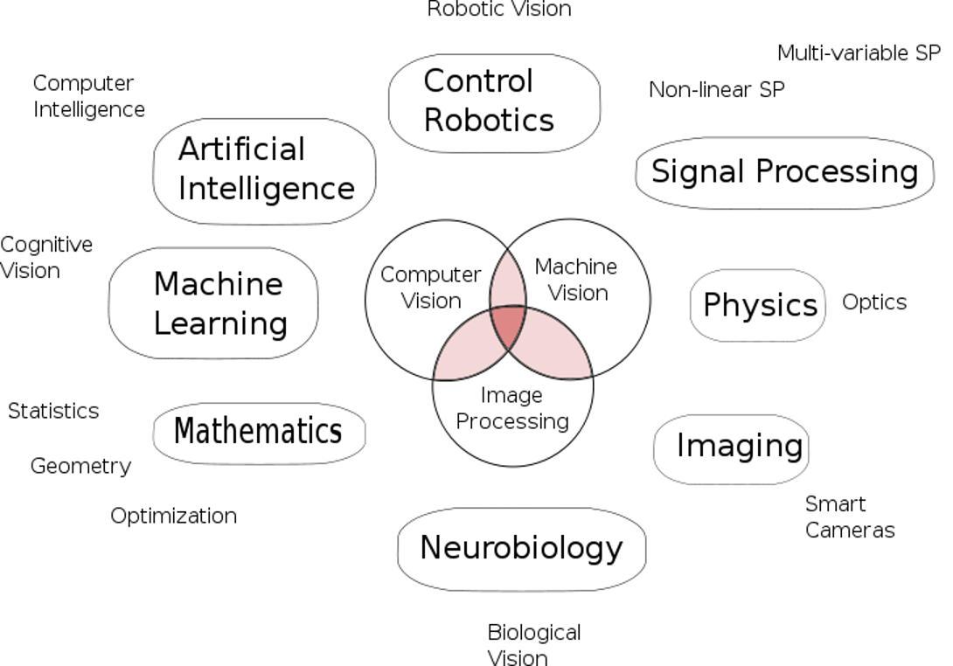
Vision is Multi-disciplinary
CV 1: Introduction to Computer Vision

Slide 17
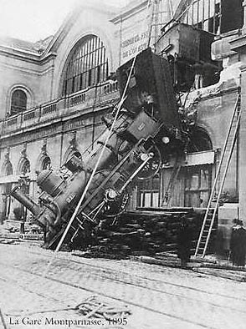
Every image tells a story
CV 1: Introduction to Computer Vision
Goal of computer vision: perceive the “story” behind the picture
Compute properties of the world
3D shape
Names of people or objects
What happened?

Slide 18
Can computers match human perception?
CV 1: Introduction to Computer Vision
Yes and no (mainly no)
computers can be better at “easy” things
humans are better at “hard” things
But huge progress
Accelerating in the last five years due to deep learning
What is considered “hard” keeps changing

Slide 19

But humans can tell a lot about a scene from a little information…
CV 1: Introduction to Computer Vision
Source: “80 million tiny images” by Torralba, et al.

Slide 20
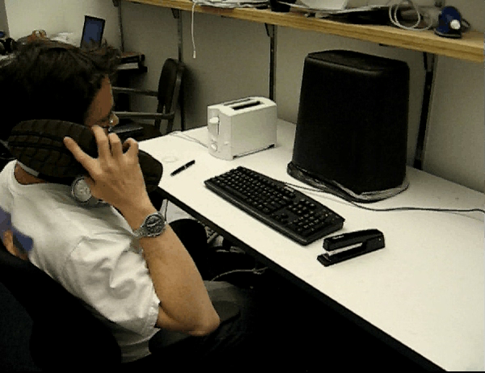

What is in here?
CV 1: Introduction to Computer Vision

Slide 21
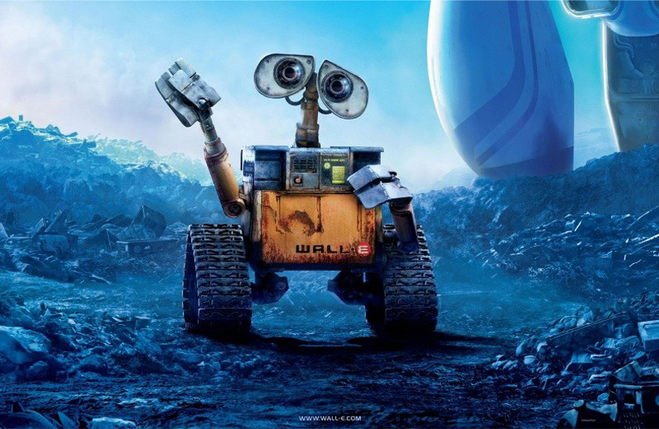
The goal of computer vision
CV 1: Introduction to Computer Vision

Slide 22
Applications of Computer Vision
🟨 Where is it used?
Healthcare: Tumor detection in X-rays
Autonomous Driving: Lane detection, pedestrian recognition
Retail: Amazon Go cashier-less stores
Agriculture: Crop health monitoring via drones
Manufacturing: Product quality inspection
Social Media: Filters, tagging, background removal
🧠 Analogy:
“Think of Computer Vision as the digital equivalent of a quality inspector, security guard, or even your family doctor—just working at scale and speed.”

Slide 23
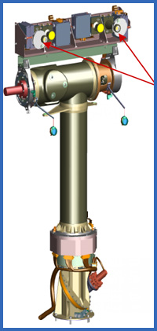
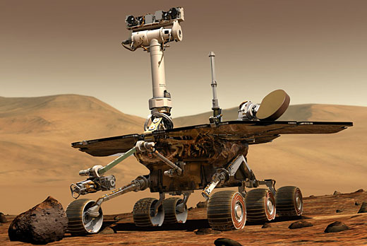
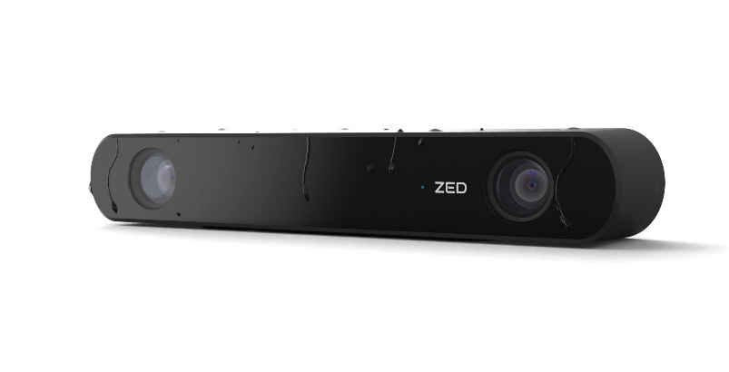
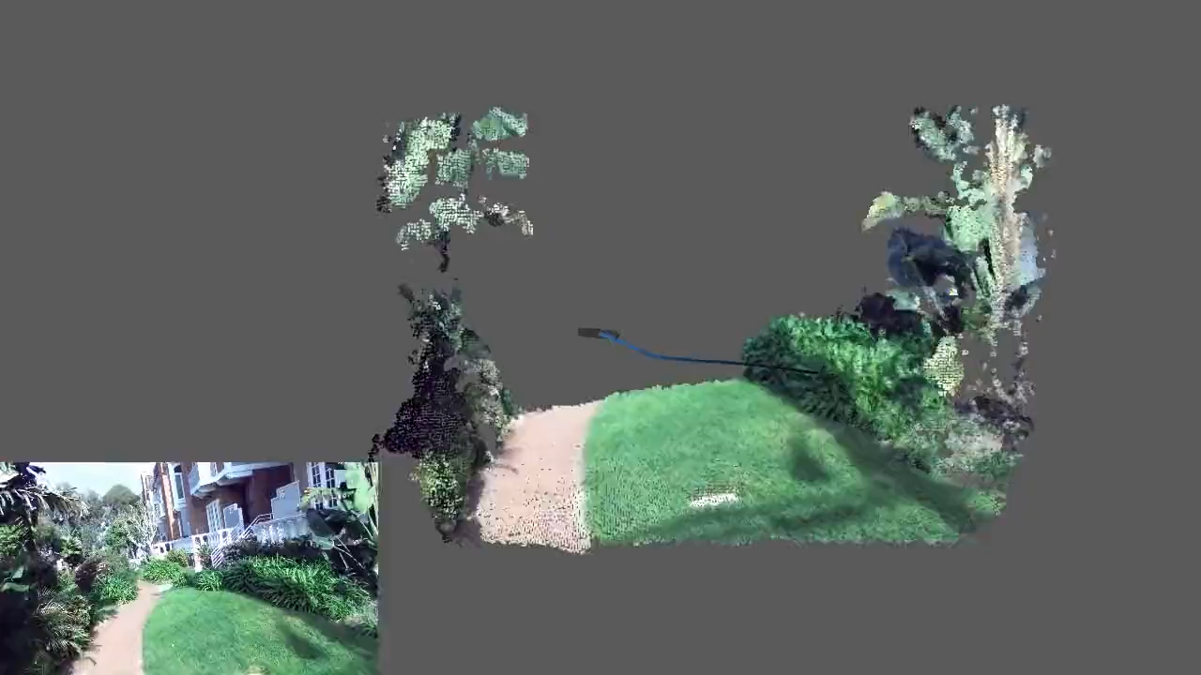
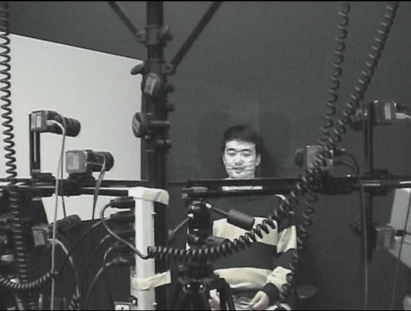
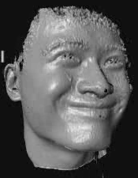
The goal of computer vision
CV 1: Introduction to Computer Vision
Compute the 3D shape of the world
ZED 2i Camera

Slide 24
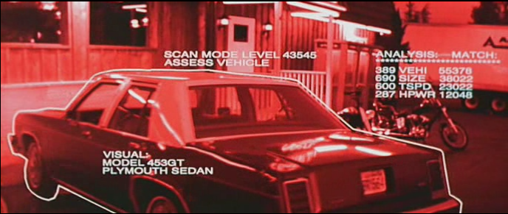
The goal of computer vision
CV 1: Introduction to Computer Vision
Recognize objects and people
Terminator 2, 1991

Slide 25
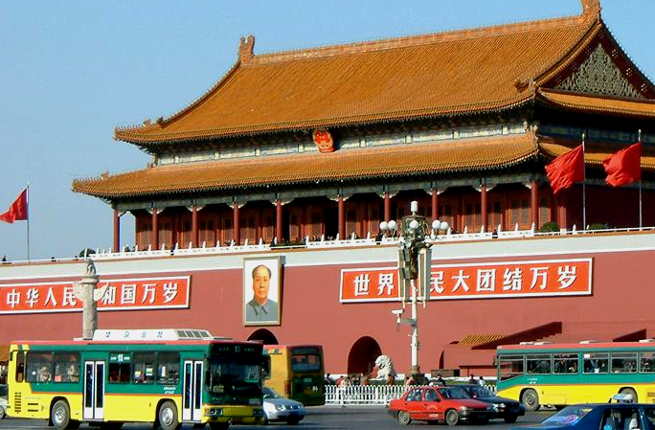
slide credit: Fei-Fei, Fergus & Torralba

Slide 26
sky
building
flag
face
banner
wall
street lamp
bus
bus
cars
slide credit: Fei-Fei, Fergus & Torralba

Slide 27
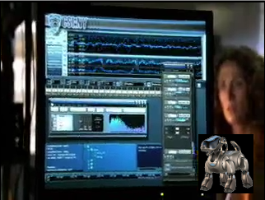
The goal of computer vision
“Enhance” images

Slide 28
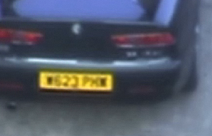
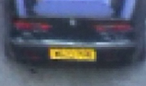
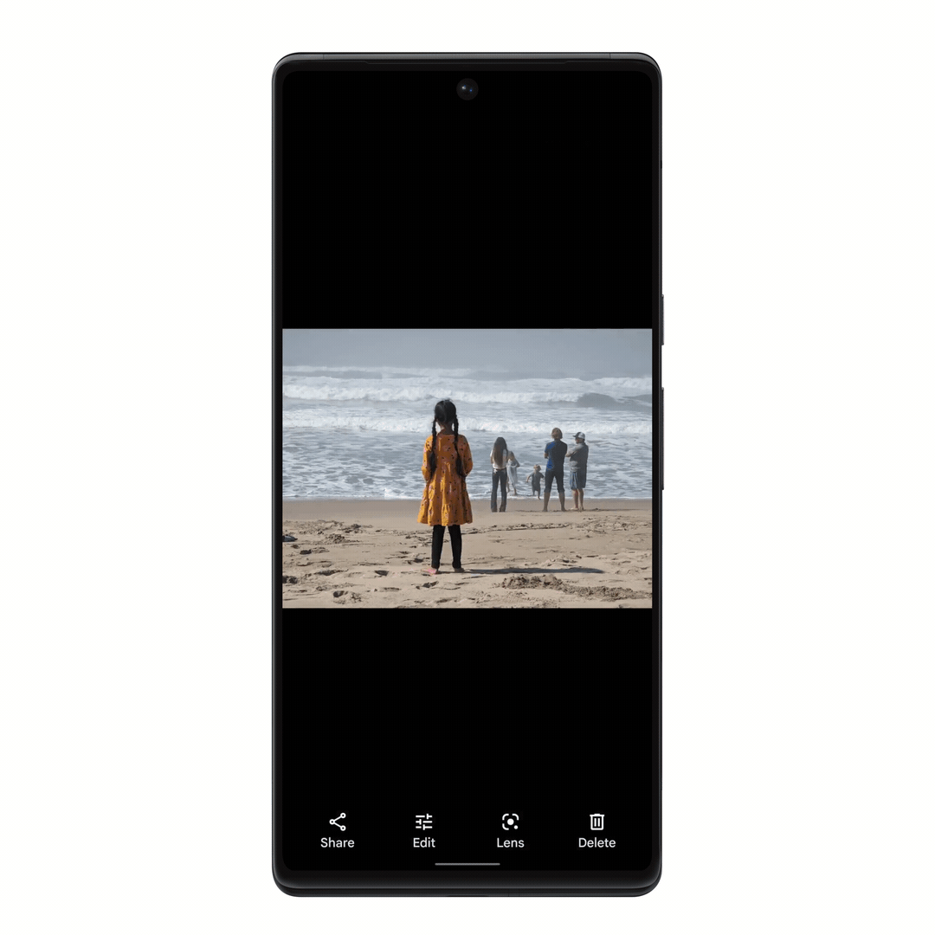
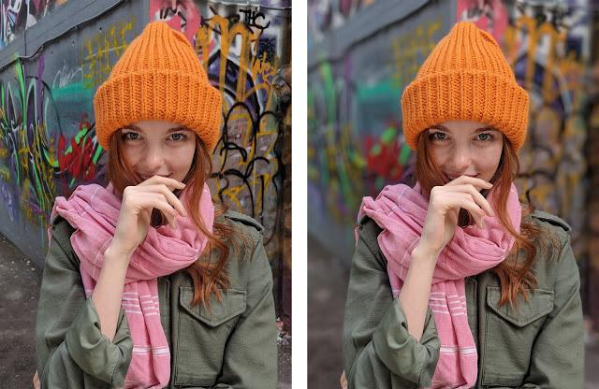
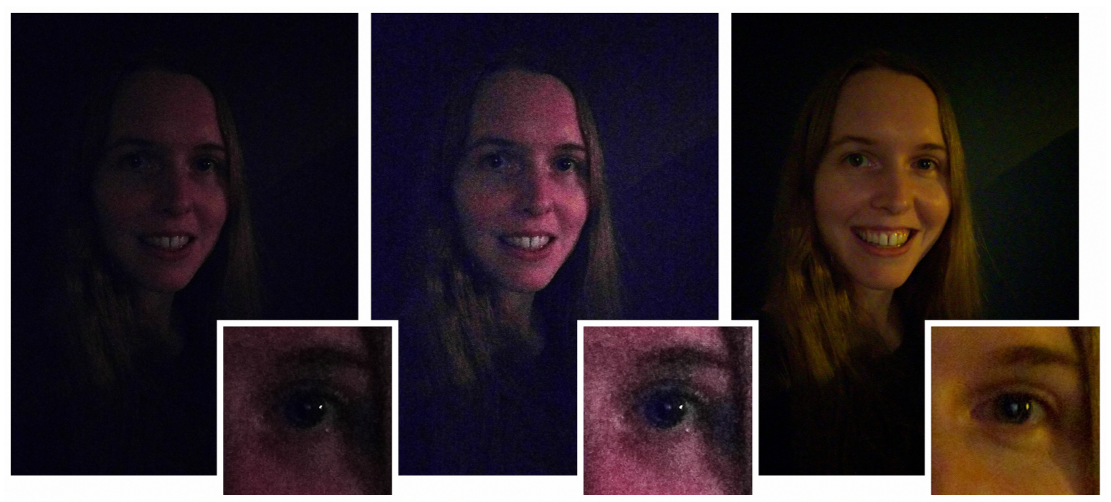
The goal of computer vision
Improve photos (“Computational Photography”)
Super-resolution (source: 2d3)
Depth of field on cell phone camera (source: Google Research Blog)
Removing objects (Google Magic Eraser)
Low-light photography
(credit: Hasinoff et al., SIGGRAPH ASIA 2016)

Slide 29

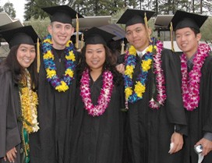
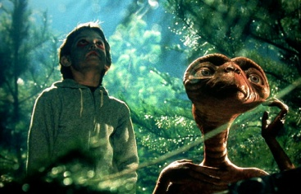
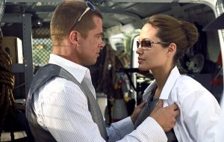
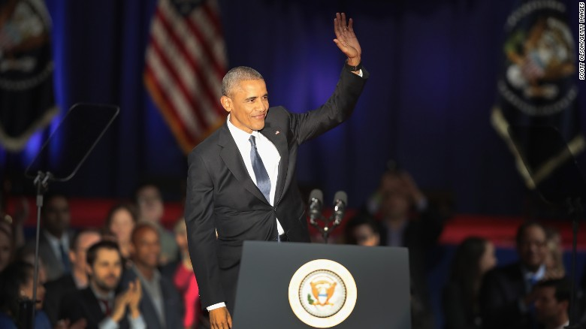
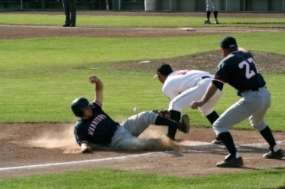
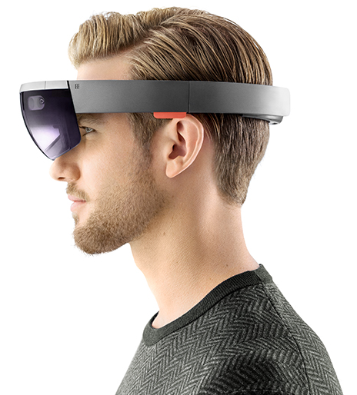






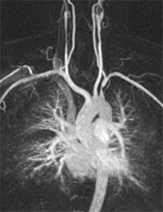
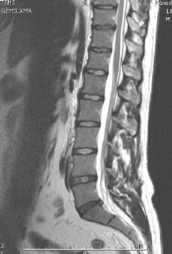
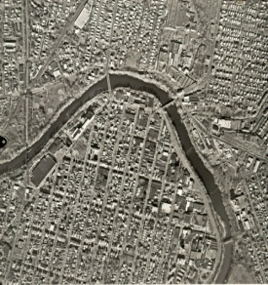
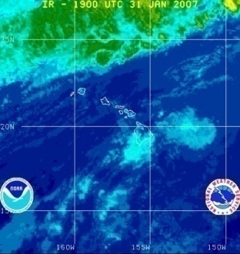
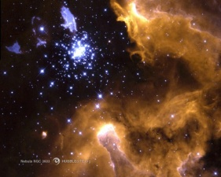
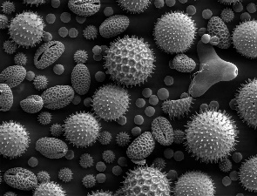
Why study computer vision?
Billions of images/videos captured per day
Huge number of potential applications

Slide 30

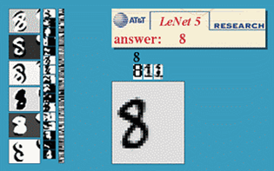
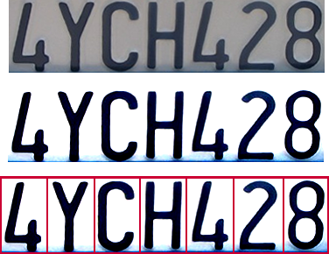


Optical character recognition (OCR)
CV 1: Introduction to Computer Vision
If you have a scanner, it probably came with OCR software
Digit recognition, AT&T labs (1990’s)
http://yann.lecun.com/exdb/lenet/
License plate readers
http://en.wikipedia.org/wiki/Automatic_number_plate_recognition
Sudoku grabber
http://sudokugrab.blogspot.com/
Automatic check processing

Slide 31

Face detection
Nearly all cameras detect faces in real time
(Why?)
Notes:
Why would this be useful? Main reason is focus. Also enables “smart” cropping.

Slide 32

Face analysis and recognition

Slide 33


Login without a password
Fingerprint scanners on many new smartphones and other devices
Face unlock on Apple iPhone X See also http://www.sensiblevision.com/

Slide 34

Bird identification
Merlin Bird ID (based on Cornell Tech technology!)
Notes:
Merlin offers quick identification help for all levels of bird watchers and outdoor enthusiasts to help you learn about the birds in any country in the world.

Slide 35


Image synthesis
“An astronaut riding a horse in a photorealistic style” – DALL-E 2
“A photo of a Corgi dog riding a bike in Times Square. It is wearing sunglasses and a beach hat” – Imagen

Slide 36

Which face is real?
https://www.whichfaceisreal.com/

Slide 37

Smart cars
Mobileye
Tesla Autopilot
Safety features in many cars

Slide 38




Robotics
NASA’s Mars Curiosity Rover
https://en.wikipedia.org/wiki/Curiosity_(rover)
Amazon Picking Challenge
http://www.robocup2016.org/en/events/amazon-picking-challenge/
Amazon Prime Air
Amazon Scout

Slide 39


Medical imaging
3D imaging (MRI, CT)
Skin cancer classification with deep learning https://cs.stanford.edu/people/esteva/nature/

Slide 40
Current state of the art
You just saw many examples of current systems.
Many of these are less than 5 years old
Computer vision is an active research area, and rapidly changing
Many new apps in the next 5 years
Deep learning powering many modern applications
Many startups across a dizzying array of areas
Deep learning, robotics, autonomous vehicles, medical imaging, construction, inspection, VR/AR, …

Slide 41

CV 1: Introduction to Computer Vision
When you look at a photo on your phone or computer, have you ever thought: What is this image made of for a machine?

Slide 42
An image is a visual representation of an object or scene that is captured using sensors like cameras or scanners. For a human, it’s something we see. For a computer, it’s a collection of numbers representing brightness or color at each point (called a pixel).

Slide 43

CV 1: Introduction to Computer Vision

Slide 44
Image representation
CV 1: Introduction to Computer Vision
Before machines understand images, they need a way to store them. That’s where image representation comes in.
Digital Image = Grid of pixels
Each pixel has a value:
Grayscale: 0 (black) to 255 (white)
Color (RGB): 3 values per pixel (Red, Green, Blue)
Resolution = Width × Height
Analogy:
Think of an image as a giant spreadsheet where each cell (pixel) holds a number representing light intensity
or color.

Slide 45
Image Analysis
“Once the computer stores an image, what can it do with it? Let’s look at the types of tasks it can perform.”
Types of Tasks:
Image Classification – What is in the image? (Cat, Car)
Object Detection – Where is the object? (Bounding boxes)
Semantic Segmentation – Which pixels belong to which object?
Instance Segmentation – Same as above but for individual instances
Tracking – Follow object across video frames
🧠 Analogy:
“If classification is like identifying fruits in a basket, then detection is pointing to where the apple is. Segmentation is drawing a perfect outline around it.”

Slide 46
Wrap-up + QA
So today we learned the basics of Computer Vision: what it is, where it’s used, and how computers store and understand images.
Ask 2–3 recap questions:
What are common challenges in computer vision?
What’s the difference between detection and segmentation?
Tease Next Class:
In the next session, we’ll go deeper into digital images—how they’re formed, how resolution and sampling affect quality, and different image types like grayscale, binary, and color.

Slide 47
Hands-on session
CV 1: Introduction to Computer Vision
https://github.com/aakashgoel12/BITS/blob/main/ComputerVision/Class%2001%20Introduction/Basic_Image_details.ipynb

Slide 48
Python Programming Resources
🔰 Beginner-Friendly Interactive Platforms
W3Schools Python Tutorial (https://www.w3schools.com/python/)
Simple, example-driven explanations.
Ideal for quick learning and revision.
Programiz Python (https://www.programiz.com/python-programming)
Great beginner content with code editors built in.
Clean explanations of syntax and structure.
Real Python
Best for professionals. Well-written tutorials and use cases.
Also includes data science, automation, and system integration topics.
📚 Courses
Coursera - Python for Everybody (by University of Michigan)
Great pace, instructor, and real-world relevance.
edX - Introduction to Python Programming
Free access with optional certification.

Slide 49
Python Programming Resources
🧪 Python for Engineering & Automation
PyPI: Industrial Automation Libraries
Find packages like opcua, pyserial, modbus-tk for interfacing with industrial devices.
Python for PLC and SCADA integration (GitHub)
Open-source OPC UA server/client library in Python.
Used to connect Python with SCADA systems.
📘 Books
"Automate the Boring Stuff with Python" by Al Sweigart
Online Free Book
Ideal for automating Excel, file systems, logging, etc. (perfect VBA replacement)
"Python Crash Course" by Eric Matthes
Excellent structured introduction with projects.

Slide 50
Thank you
CV 1: Introduction to Computer Vision

